Slide 1
EE 488 Progress 3→4→ Final

Slide 2
c
Establish Basic Tx/RX Connection
Tx/Rx MIMO Capability
(via any transmission mode)
2x2 MIMO with Alamouti Coding
2x2 MIMO with Multiplexing
Receive with MRC

Slide 3
Establish Basic Tx/RX Connection
Tx/Rx MIMO Capability
(via any transmission mode)
2x2 MIMO STBC with Alamouti Coding
2x2 MIMO with Multiplexing
Diversity Embedded Codebook

Slide 4
Establish Basic Tx/RX Connection
Tx/Rx MIMO Capability
(via any transmission mode)
2x2 MIMO STBC with Alamouti Coding
2x2 MIMO with Multiplexing
Diversity Embedded Codebook

Slide 5
Establish Basic Tx/RX Connection
Tx/Rx MIMO Capability
(via any transmission mode)
2x2 MIMO with Alamouti Coding
2x2 MIMO with Multiplexing
Receive with MRC

Slide 6
Establish Basic Tx/RX Connection
Tx/Rx MIMO Capability
(via any transmission mode)
2x2 MIMO with Alamouti Coding
2x2 MIMO with Multiplexing
Receive with MRC

Slide 7
Microphone
Music
MUX (2:1)
ESP 32 (Master)
DEMUX (1:3)
ESP 32 (Slave)
ESP 32 (Slave)
ESP 32 (Slave)
Amplifier
Amplifier
Amplifier
Speaker #1
Speaker #2
Speaker #3

Slide 8
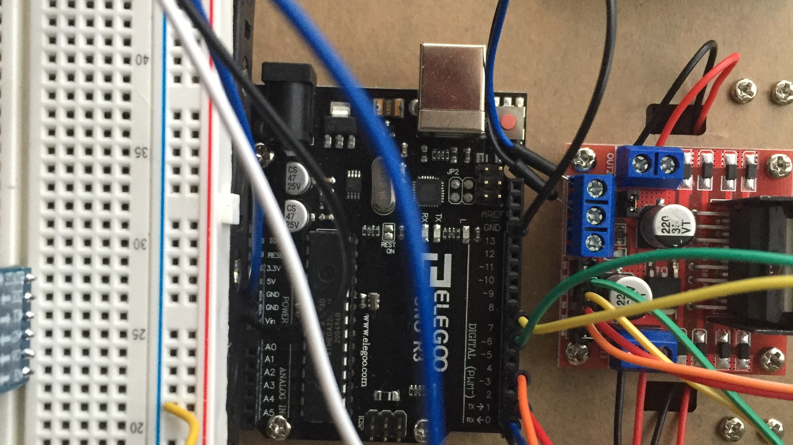
5V
AD2

Slide 9
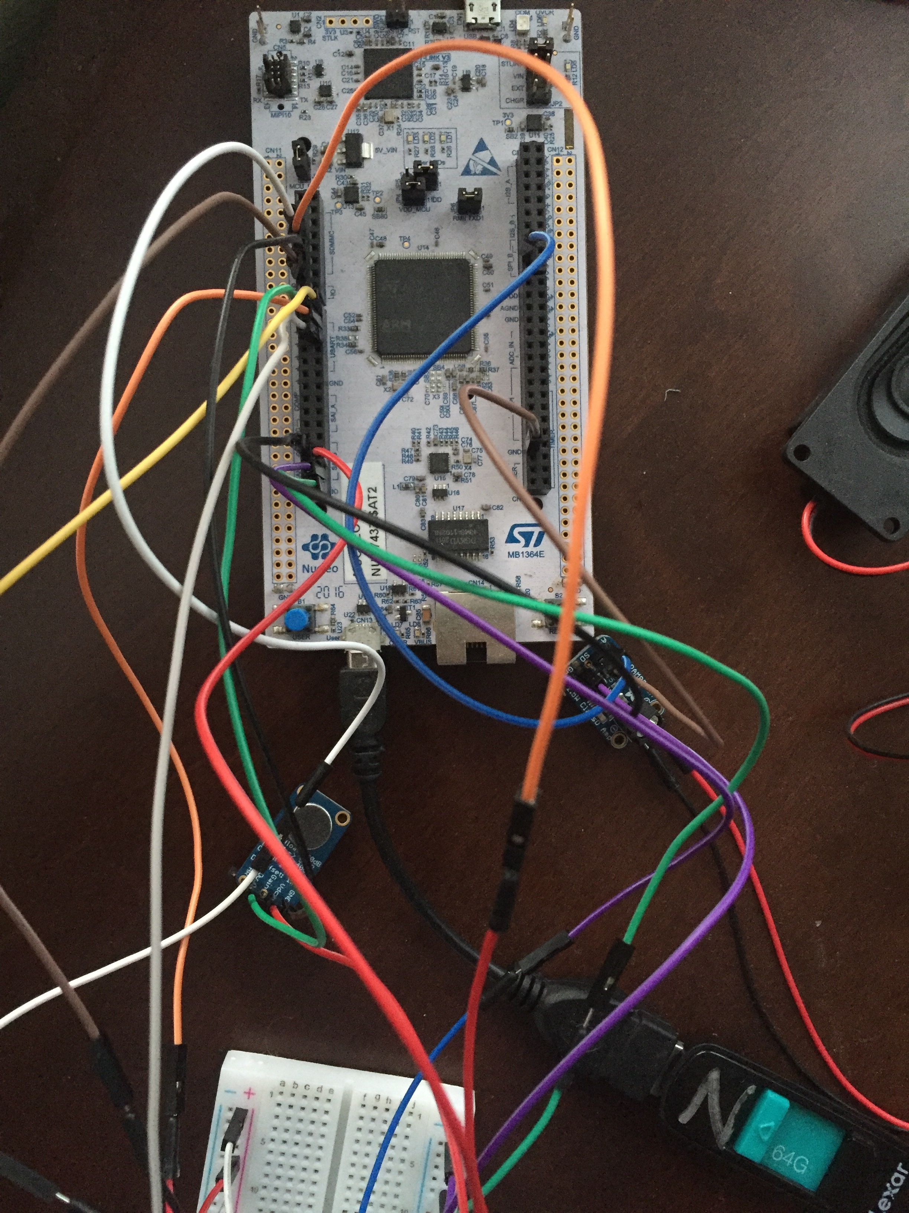
3.3 V (Bread Left)
5V (Bread Right)
GND (Mic)
PA4 (Amp A+)
GND (Bread)
PA3 (Mic)
PD7 (Button)
PD6 (RX)
PD5 (TX)
GND (Amp)
GND (Amp A-)
PF7 (RED LED)
PF9 (YELLOW LED)
PG1 (GREEN LED)

Slide 10
3.3 V (Bread Left)
5V (Bread Right)
GND (Mic)
PA4 (Amp A+)
GND (Bread)
PA3 (Mic)
PD7 (Button)
PD6 (RX)
PD5 (TX)
GND (Amp)
GND (Amp A-)
PF9 (YELLOW LED)
PG1 (GREEN LED)

Slide 11
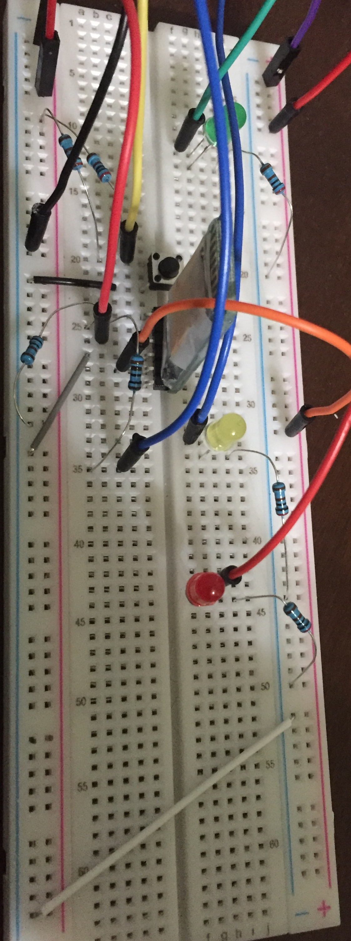
3.3V (H7)
3.3V (Mic)
5V (Amp)
PG1
5V (H7)
GND (H7)
PD7
RX (H7)
2k
1k
5V (Blue)
PF9
TX (H7)
Note:
TX (H7) -> RX (Bluetooth)
RX (H7) -> TX (Bluetooth)
PF7

Slide 12
3.3V (H7)
5V (Amp)
3.3V (Mic)
PG1
5V (H7)
GND (H7)
PD7
RX (H7)
2k
1k
5V (Blue)
PF9
TX (H7)
Note:
TX (H7) -> RX (Bluetooth)
RX (H7) -> TX (Bluetooth)

Slide 13
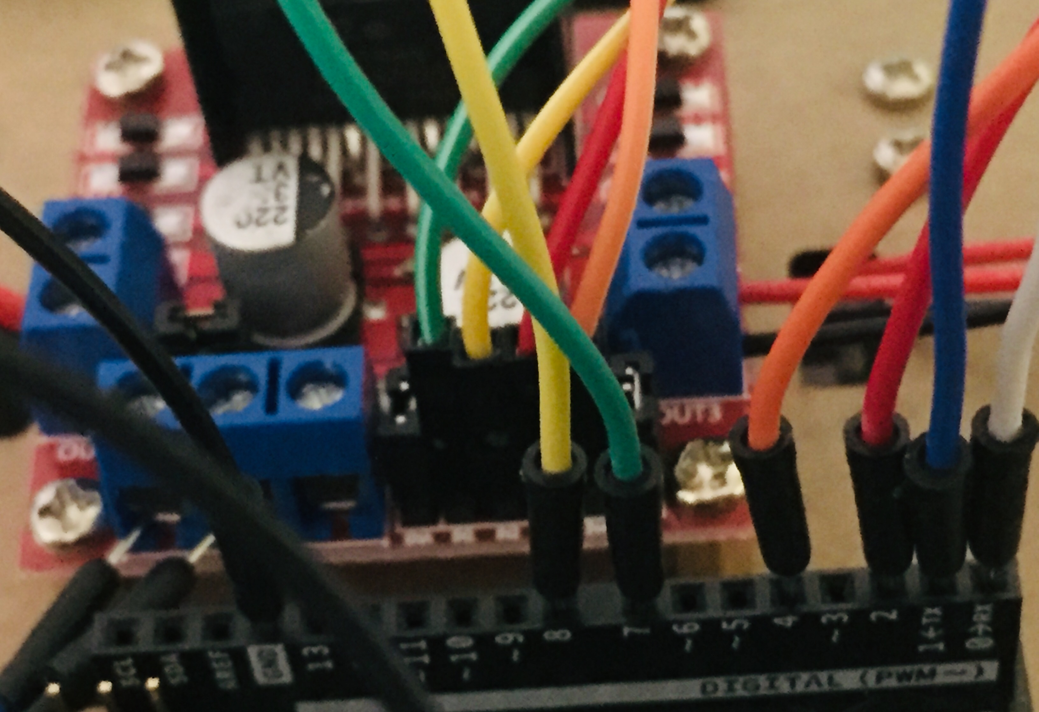
IN1, IN2, IN3, IN4
TX, RX

Slide 14
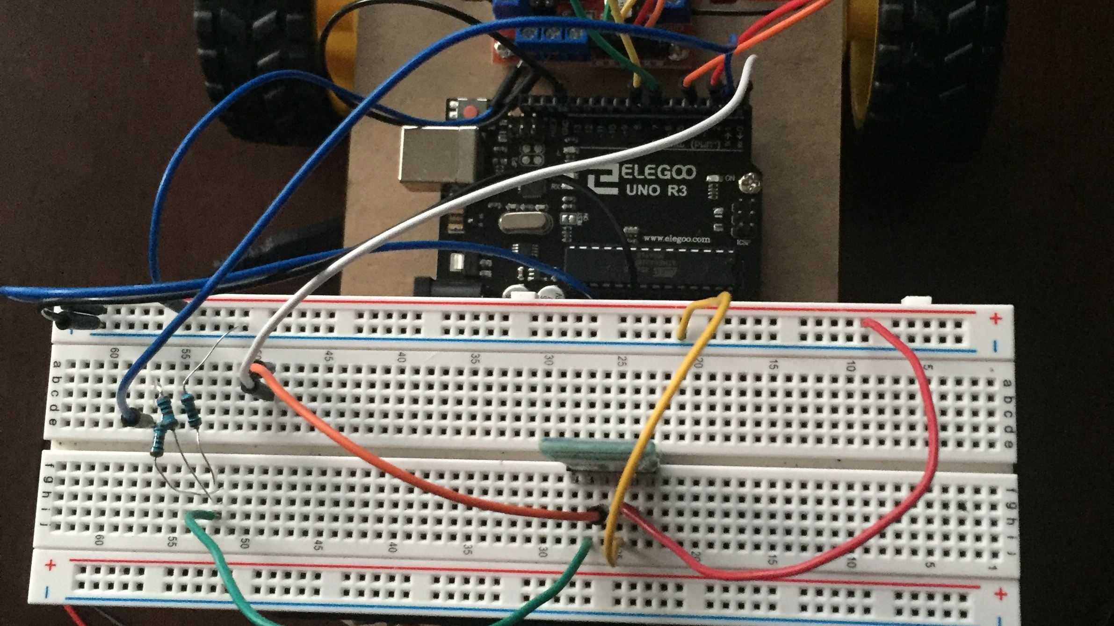
5 V (Uno)
5 V (Red Board)
Note:
TX (Uno) -> RX (Bluetooth)
RX (Uno) -> TX (Bluetooth)
5 V (blue)
GND (Uno)
GND (blue)
RX (Uno)
2k
= TX (blue)
1k
TX (Uno)
RX (blue)

Slide 15
H7
CAR
MM
MM
MM
RX
TX
“Master” Bluetooth
“Slave” Bluetooth
TX
RX
Arduino Uno
L298N Red Board
H7
TX
RX
RX
TX

Slide 16
H7
MM
MM
MM
87 Frames
4s Input
Word Detector
Multiply by Hamming Window
FFT
|FFT|²
MM
MM
“Slave” Bluetooth
TX
RX
Arduino Uno
L298N Red Board
RX
TX
CAR

Slide 17
MFCC
MM
MM
26-Element Energy Vector
87 Frames
PSD
Filter Bank + log (multiply & accum)
13 x 87
Matrix
FFT
|FFT|²
DCT

Slide 18
CNN
MM
MM
MM
Detected
Word
13 x 87
Matrix
Convolutional (16 Filters)
Max Pooling (2, 2)
Convolutional (32 Filters)
Flatten + Dense
Max Pooling (2, 2)

Slide 19
Word #1:
Command
MM
87
Frames
13 x 87
Matrix
Hamming Window
13 MFCC’s per Frame
Detected Command
CNN
4 Second Input
Word Detector
MM
87
Frames
13 x 87
Matrix
Detected Distance/ Angle
Hamming Window
13 MFCC’s per Frame
CNN
Word #2:
Distance/
Angle

Slide 20
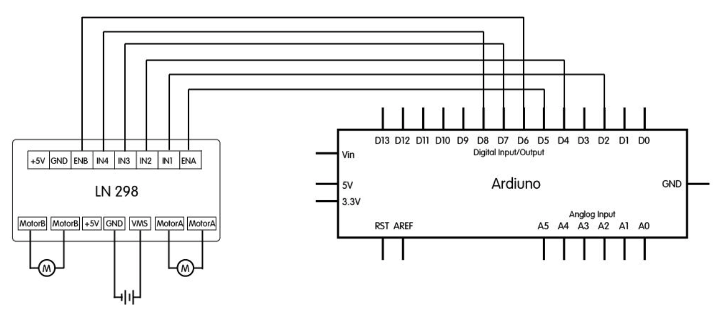
RX
TX

Slide 21
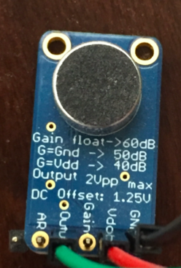
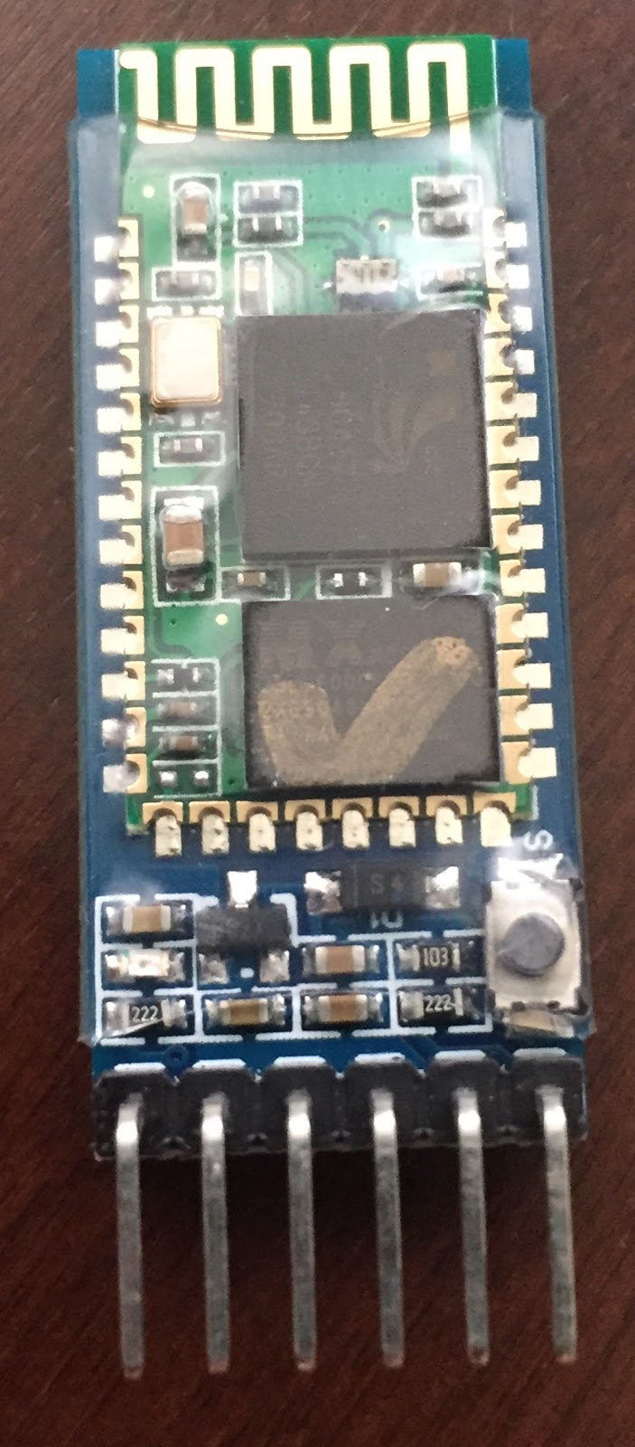
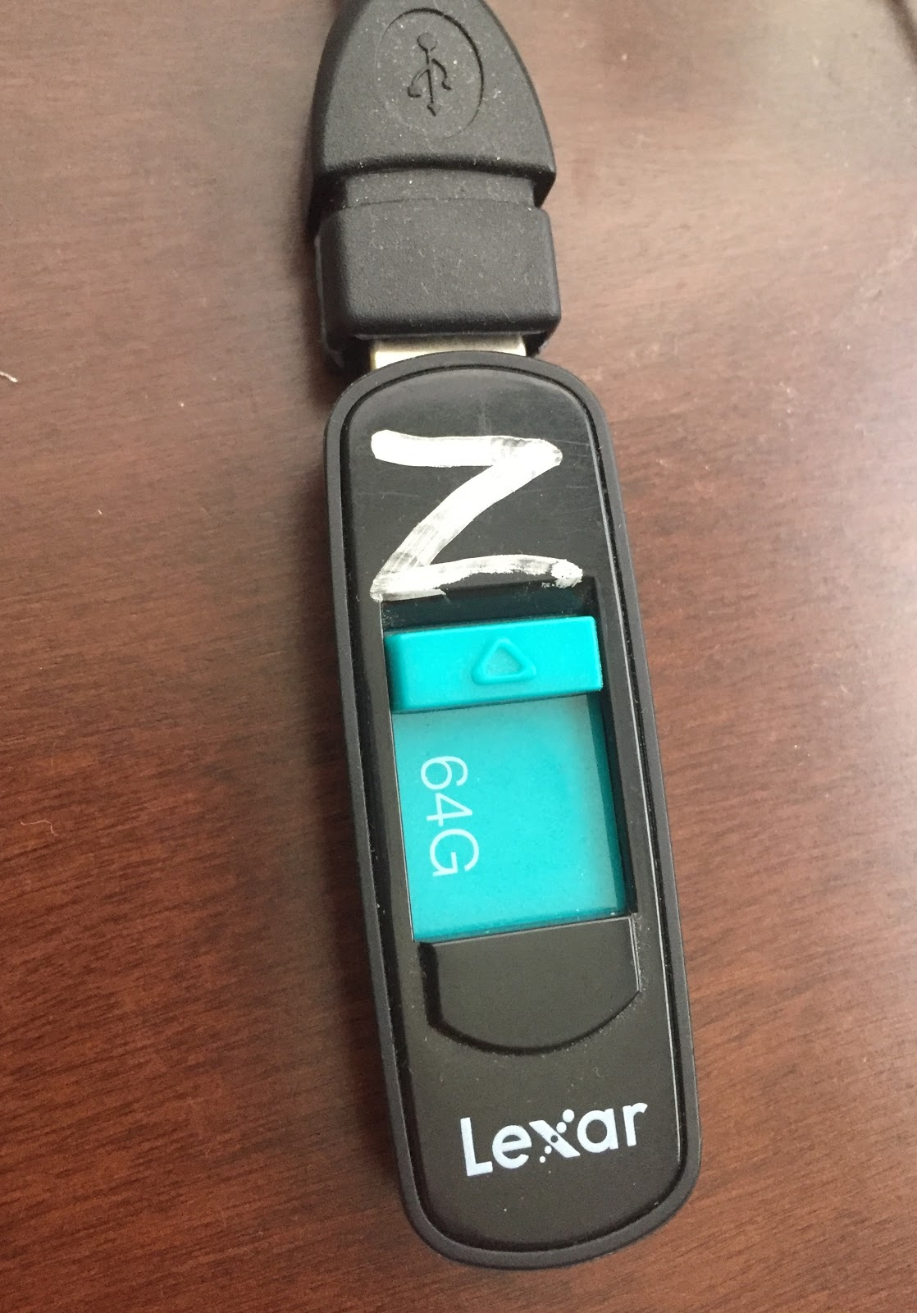
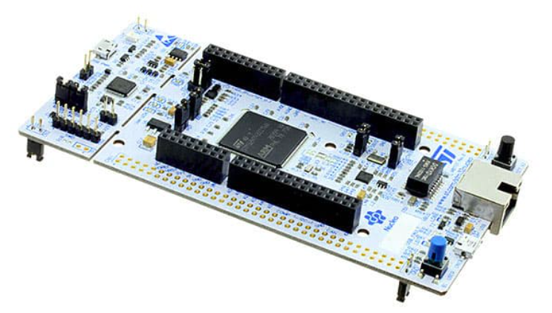
Microphone
HC-05 Bluetooth Module (Master)
USB
H7 Nucleo Board

Slide 22
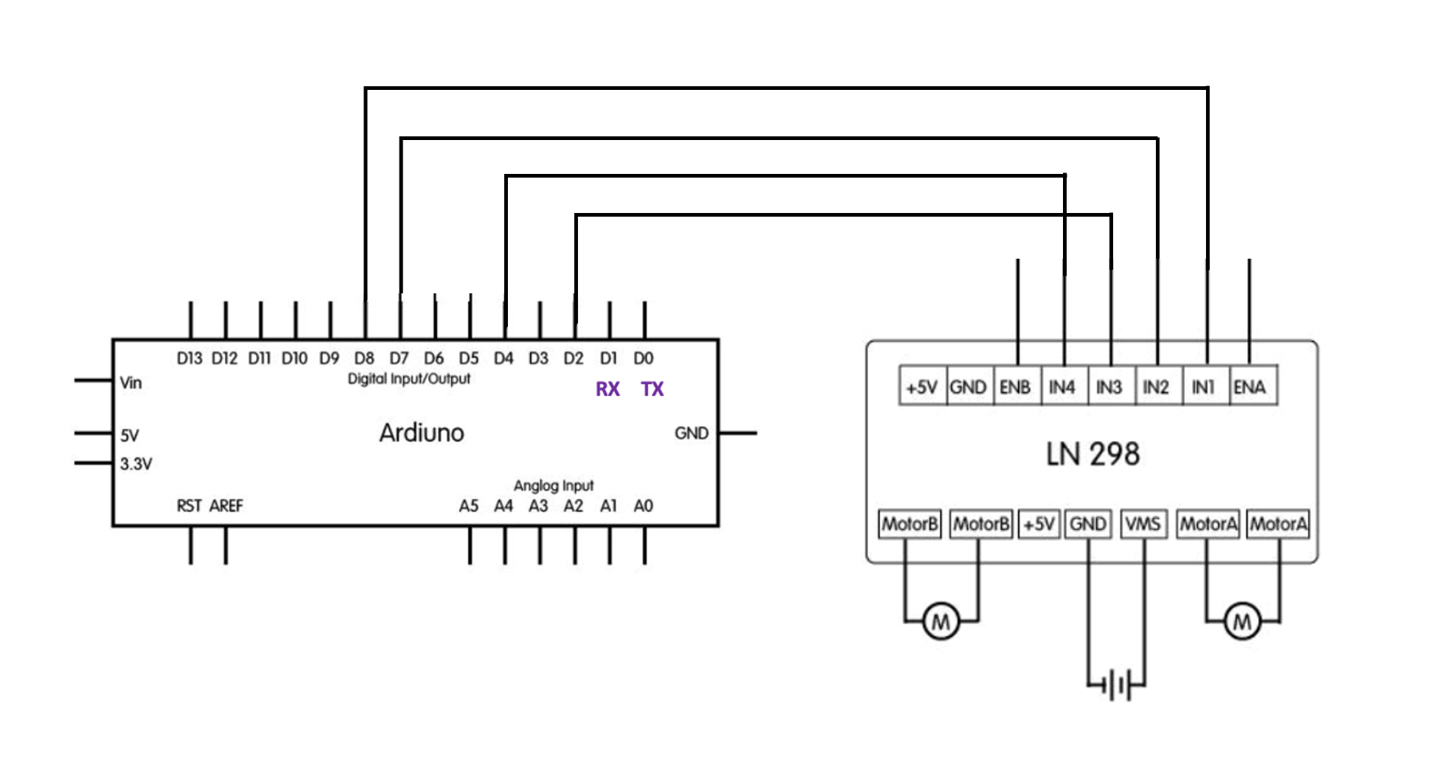

Slide 23
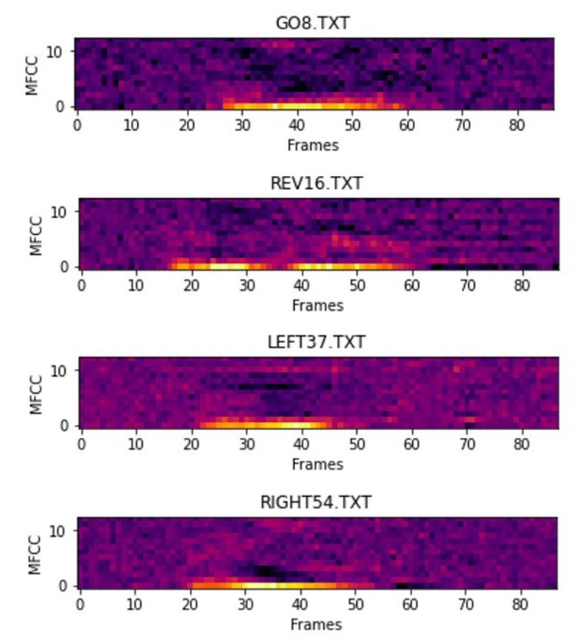
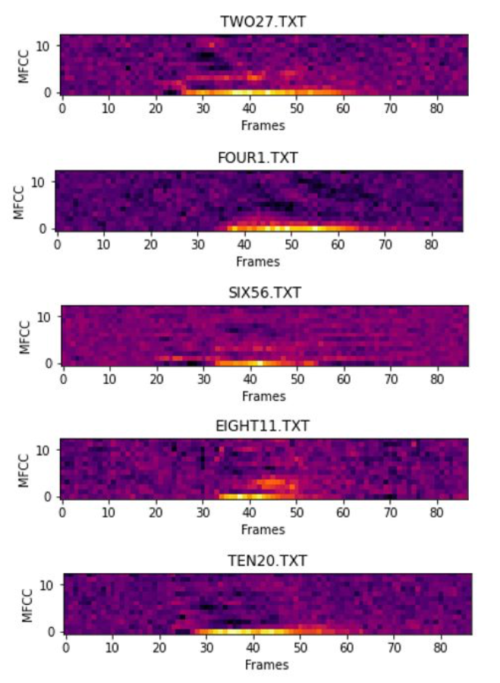
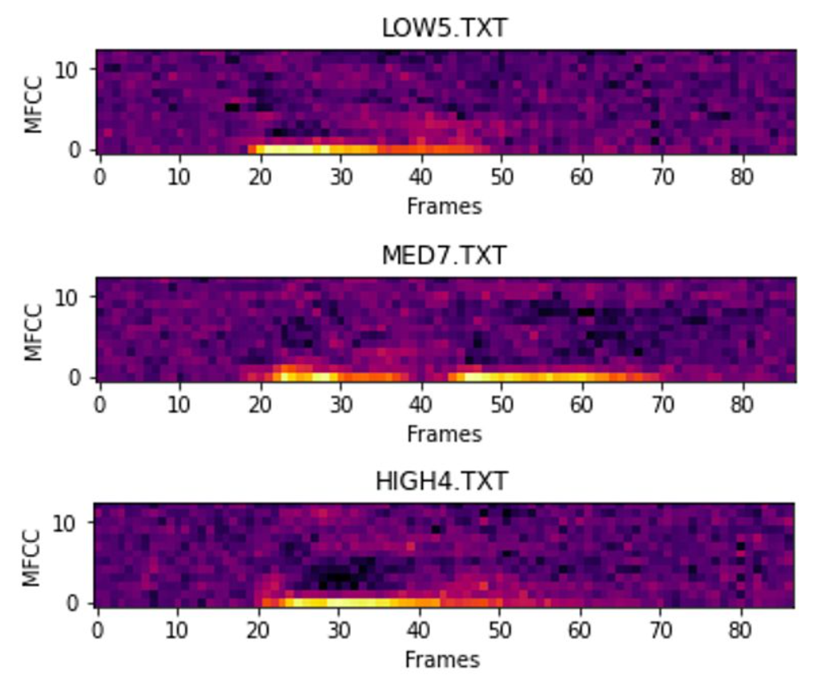
Command Word:
Distance:
Angle:

